Slide 1

Github,Github Commands

Slide 2

What is Github?
Why i use Github?

Slide 3





Slide 4

Git
Git is a free and open source distributed version control system designed to handle everything from small to very large projects with speed and efficiency.
What is Open Source?
Repository
Pull-Push
Branching and Merging
Issues

Slide 5
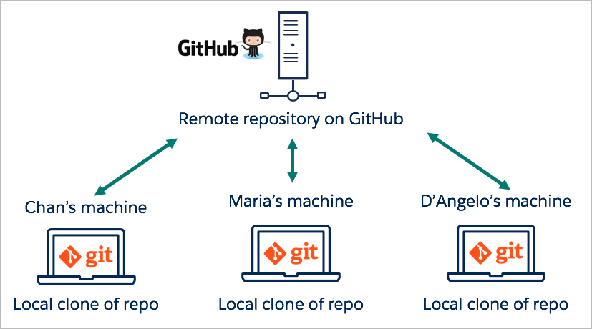
Team Work Github

Slide 6

Download Gitbash
Git - Downloads

Slide 7
Repo and CMD
Public/Private
*Settings of Repo
Gitbash- create our first Repo
CMD commands:
cd,pwd,ls,mkdir,touch,clear

Slide 8
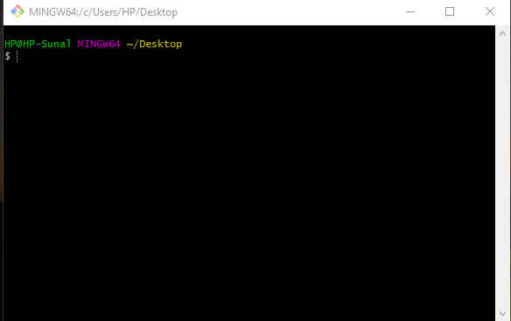
Some Gitbash Commands and Terminal
Pwd – Print Working Direction
Cd- Change Directory
Mkdir- make Directory “Directory Name”(Create Folder)
Rmdir- Remove directory (Remove Folder)
Touch- Creat File(Exam:index.html)
Rm-Remove File
Ls- List

Slide 9
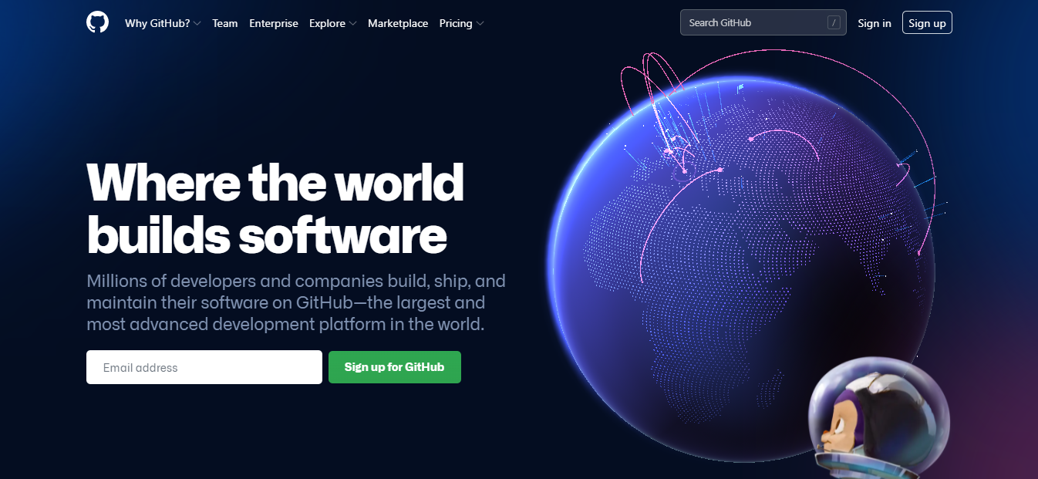
Sign up Github https://github.com/

Slide 10




Let’s upload our task Github
git branch –M main
base branch make main branch
Git push –u origin main
Upload folder main branch repository

Slide 11

First time Upload Folder and Files Github

Slide 12
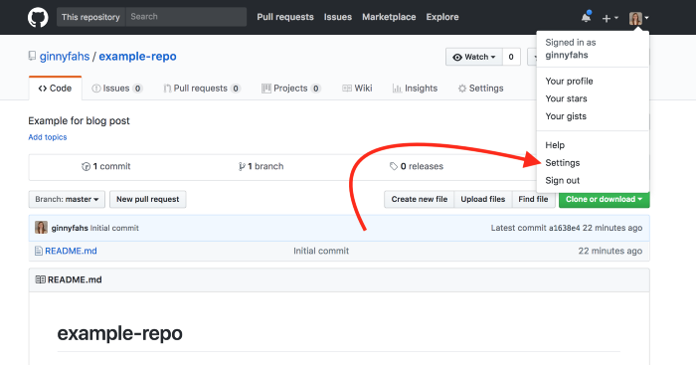

Slide 13
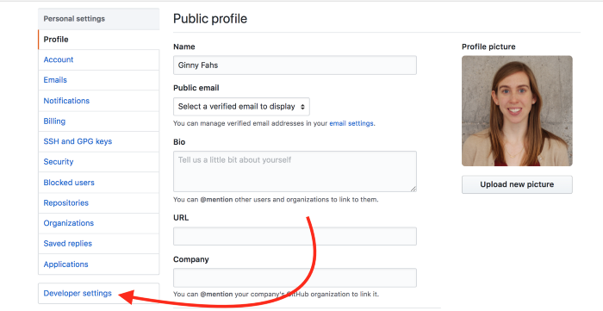

Slide 14
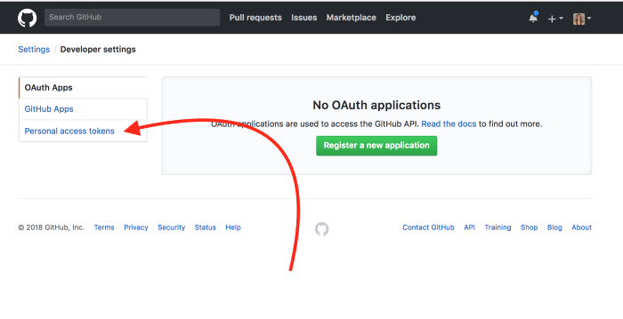

Slide 15
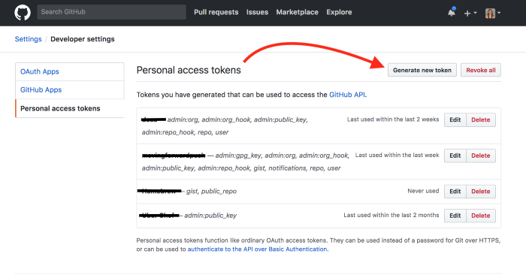

Slide 16
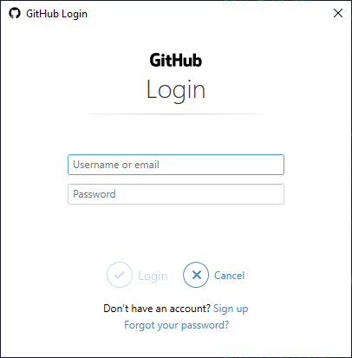
Enter Your Email Adress
Enter Password input your generate token

Slide 17
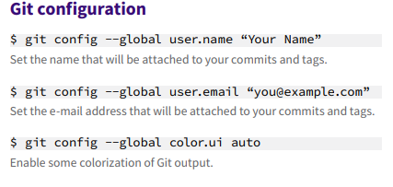




Git Stage

Slide 18
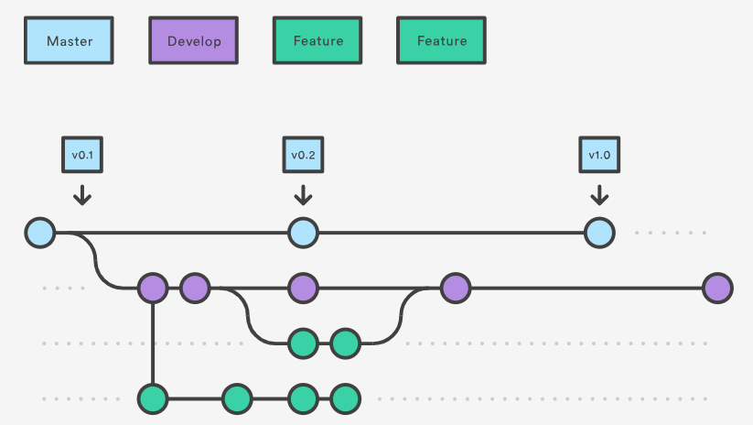

Slide 19
Thanks !

